Slide 1


Introduction to HTML & CSS
Instructor: Beck Johnson Week 2

Slide 2

today
Week One review and questions
File organization
CSS Box Model: margin and padding
Background images and gradients with CSS
Make a hero banner!

Slide 3

REVIEW!

Slide 4



REVIEW: WEBPAGE COMPONENTS
html
Structures and organizes content
css
Styles the markup and creates layout
Javascript
Brings content and design to life

Slide 5
REVIEW: HTML DOCUMENTS
<!DOCTYPE html> tells the browser it's serving an HTML file using HTML5 standards
<html> wraps the whole document
<head> wraps the metadata and styles
<body> wraps the visible content
Most HTML elements have opening and closing tags and some have attributes

Slide 6
REVIEW: layout elements
<header> wraps header content
<footer> wraps footer content
<nav> indicates that everything inside is related to navigation
<section> is used to define content sections

Slide 7
REVIEW: HTML CONTENT
Headings create an header/outline
<h1>...<h6>
Paragraphs and lists structure text
<p>
<ul>
<ol>
Images and links both require attributes to work

Slide 8
Review: IMAGES
<img src="kitten.jpg" alt="Cute kitten" />
Does not have a closing tag (“self-closing”)
Two required attributes:
src is where the file lives (local or external)
alt is a description of the image (used for screen readers, search engines, etc.)

Slide 9
Review: Links
<a href="http://google.com">Google</a>
Creates a link to other pages or websites
The href attribute says where the link should go
Anything inside <a> tags is clickable

Slide 10
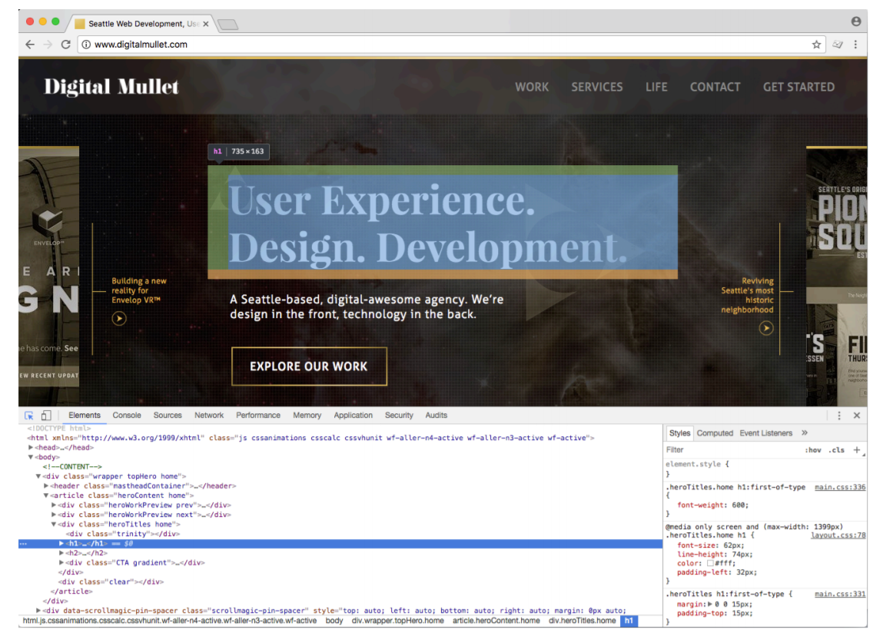
Review: Dev tools
Right-click > Inspect, or hit the F12 key

Slide 11
REVIEW: Css
CSS (Cascading Style Sheet) is a different type of language than HTML, and has its own syntax
CSS can go directly in your HTML file, inside a <style></style> element
CSS can be added in a separate .css file that can be linked to your HTML page

Slide 12
REVIEW: EXAMPLE CSS RULE
p { color: blue; }
selector is p (all <p> tags in the HTML)
property is color
value is blue (many color names are supported, or use the hex code #0000ff)

Slide 13
QUESTIONS?

Slide 14

FILE ORGANIZATION

Slide 15
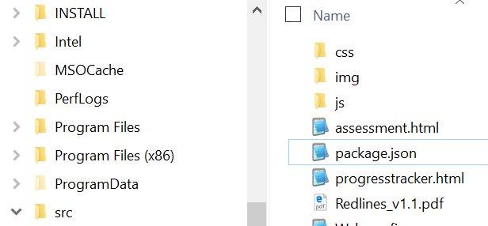
FILE ORGANIZATION
Typical files in a website include:
HTML files (.html)
CSS files (.css)
Javascript files (.js)
Images (.png, .jpg, .gif)
Usually devs make subdirectories for media, CSS, and
Javascript files

Slide 16
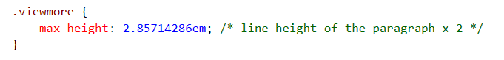
Code organization
Comment your files – especially if you have unfinished development code, or if you think you may forget why you made the decision you did
Indent and space out your code so that it’s easier for you to read

Slide 17
FILE Naming RULES
Spaces in folders or file names can cause issues
Most devs prefer to separate words in files using capitalization, dashes, or underscores
likeThis
or-this
this_is_also_used

Slide 18
Url-scuse me?
A URL is a path to a file, either on your computer or a remote computer (a “server”)
When you type an URL into your browser, it’s navigating to a file stored on a server
When you use an URL in a src for an <img> tag, it finds that image by navigating to that location, starting from the folder that the HTML file is inside
<img src="image.gif" />

Slide 19
absolute FILE PATHS
Absolute paths are URLs that start with http or https
<a href="http://google.com">Ubiquitous search engine</a>
Because these files are not hosted by you, if someone renames or deletes the file, your link will be broken

Slide 20
Relative file Paths
Relative paths are URLs that are located relative to your current file
Relative paths start with / or ../ or are a filename
Any files that are saved on your local drive should be linked using relative paths
<a href="other-page.html">Link to another page on my website that is in the same folder</a>

Slide 21
Relative file Paths
Use ../ in a path to navigate “up” a directory
<img src="image.gif" /> (image.gif is in same folder)
<img src="../images/image.gif" /> (image.gif is in parent folder)

Slide 22
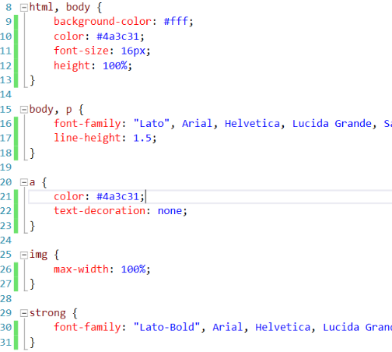
css indentation
This is one popular way to indent CSS
Starting bracket is on the same line as the selector
Each property is on its own line, tabbed once
Ending bracket is on its own line

Slide 23
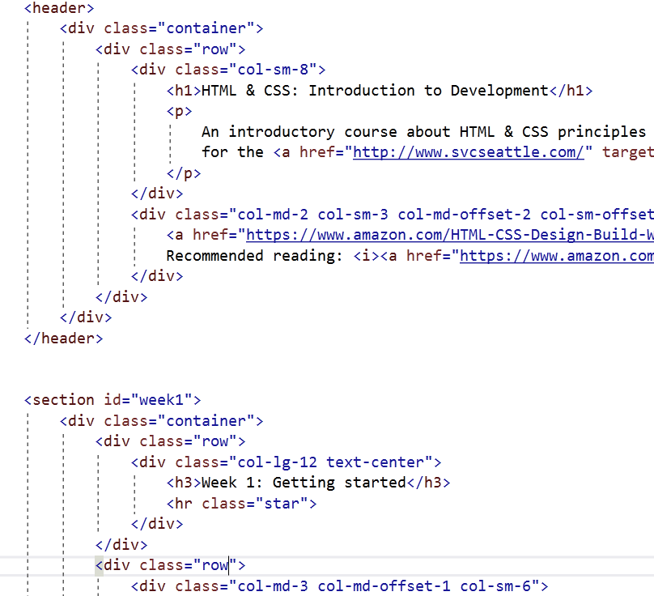
html indentation
This is a standard way to indent HTML
Children elements are tabbed once
Most elements are on a new line

Slide 24
{} CSS organization
Last week, we made CSS changes directly in the <head> element of our HTML documents
These internal styles only apply to that page (but affect every element on that page that is styled)

Slide 25
{} CSS organization
You can also add inline styles to a single element by using the style attribute in HTML markup
<p style="color: red">This paragraph is special.</p>
Inside the style attribute, use the same syntax as CSS (selector: value)
Typically discouraged, because it can be hard to maintain

Slide 26
{} CSS organization
The most common way to use CSS in the real world is to use an external stylesheet.
CSS lives in a separate .css file
The same stylesheet can be included on multiple pages
A single page can include multiple stylesheets

Slide 27
{} Linking to external stylesheet
<link href="css/styles.css" rel="stylesheet">
Tells the browser to find and load the styles.css file from a css directory
The rel attribute stands for "relation" - in this case, this link's relationship to the document is "stylesheet"
This tag goes inside the <head> element
Should be on every page that needs the styles

Slide 28
{} The “CASCADING” Part
The beauty of CSS is being able to create styles and then override them when you want to customize the look of your pages.
There are 3 rules for determining how styles get applied:
Styles are applied from far to near
Styles are applied from top to bottom
Children elements are more specific than parents

Slide 29
{} far to near
Styles that are “closer” to the elements they style take precedence, so that they apply in this order:
Browser defaults
External (from a .css file)
Internal (from styles in the <head>)
Inline (directly on the element)

Slide 30
{} Top to bottom
CSS rules are applied sequentially
If the same property is styled multiple times for the same selector, the last one wins
p | { | color: | red; | }
p | { | color: | green; | } | /* | this | one | wins | */

Slide 31
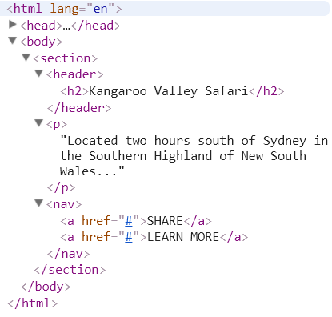
{} HTML children
In an HTML document, an element that is nested inside another element is referred to as a “child” of that element
<h2> is a child of <header>
<a> are children of <nav>
Both <a> and <h2> are also children of <section>

Slide 32
{} HTML children
In CSS, to style only elements that are inside another element, use this syntax:
parent child { property: value; }
nav a { color: #c4fe46; }
“Change the color of links that are
contained within a nav”

Slide 33
{} Children are specific
Children elements inherit styles from their parents, but can override with their own style
p { color: #daa645; } /* all paragraphs */
b { color: #e7c0c8; } /* bold text in general */
p b { color: #c4fe46; } /* bold text in paragraphs */

Slide 34
PRACTICE TIME!

Slide 35
Practice file organization
Create a folder for your images and move all images there
Fix the paths in all your <img src> tags so that images show like before
Create a new file called styles.css
Copy and paste the styles from inside <style></style> into that .css file
Add a link to your new stylesheet on all of your webpages:
<link href="styles.css" rel="stylesheet">
Prettify your CSS and HTML so that it’s easy to read
Use indentation and whitespace

Slide 36
THE CSS BOX MODEL

Slide 37
CSS BOX MODEL
Content: stuff in the box
Padding: bubble wrap and packing peanuts
Border: sides of the box
Margin: space between multiple boxes

Slide 38
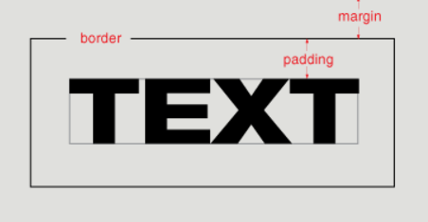
CSS BOX MODEL

Slide 39
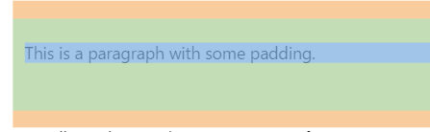
Padding
Padding creates space inside an element.
Padding affects how far content is from the border.
p {
padding-top: 20px; padding-right: 5px; padding-bottom: 40px; padding-left: 10px;
}
Shorter way:
p {
padding: 20px 5px 40px 10px;
}

Slide 40
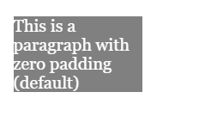
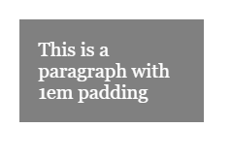
Padding
Padding is useful for moving content away from the edges of its container.

Slide 41
Padding
If top/bottom and left/right padding match…
p {
padding-top: 20px;
padding-right: 10px;
padding-bottom: 20px;
padding-left: 10px;
}
Combine them!
p { padding: 20px 10px; }

Slide 42
Padding
If all padding matches…
p {
padding-top: 20px;
padding-right: 20px;
padding-bottom: 20px;
padding-left: 20px;
}
Combine EVEN MORE!
p { padding: 20px; }

Slide 43
Padding
Padding can be applied only to the top, only to the bottom, and so on – or any combination of those:
p {
padding-left: 40px;
}
p {
padding-top: 20px;
padding-right: 10px;
}

Slide 44

MARGIN
Margin moves elements away from one another.
img {
margin: 6px;
}

Slide 45
MARGIN
Margin creates space outside an element.
Same abbreviation style and rules as padding
p {
margin-top: 20px;
margin-right: 5px;
margin-bottom: 40px;
margin-left: 10px;
}
Is the same as
p { margin: 20px 5px 40px 10px; }

Slide 46
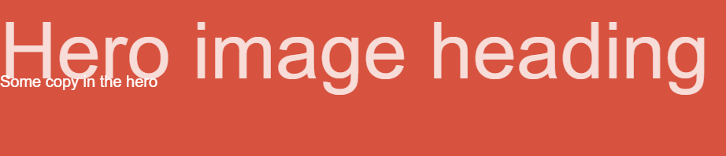
MARGIN
You can give margin a negative value to shift elements in the opposite direction.
p {
margin-top: -20px;
}
This may result in overlapping text!

Slide 47
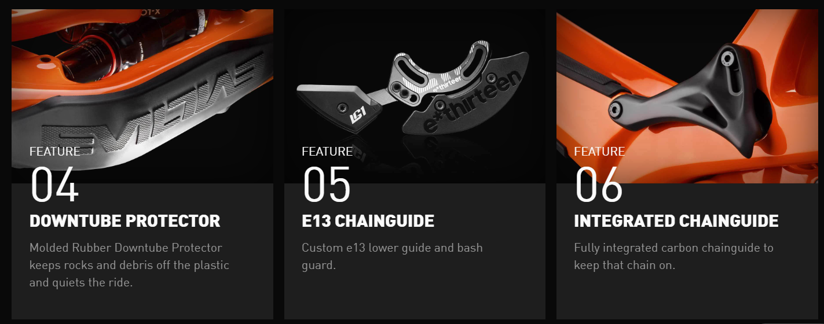
negativity
https://www.evil-bikes.com/products/following-mb

Slide 48
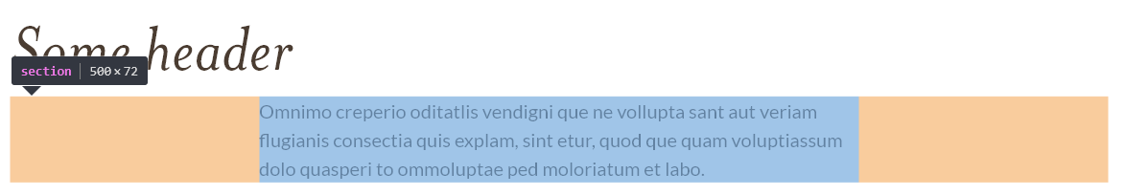
MARGIN auto
To automatically center elements, you can use the property auto, which evenly applies a margin on both sides
When using auto, a width must be applied to the element, so that the browser knows how much margin to automatically apply
section {
margin: 0 auto;
width: 500px;
}

Slide 49
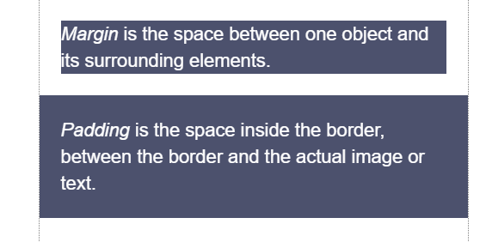
MARGIN vs. padding
Use margin to separate the element from the things that are around it.
Use padding to move the element away from the edges of the block.

Slide 50

BACKGROUND images

Slide 51
BACKGROUND COLOR review
p {
background-color: gray;
color: white;
}
This is a paragraph with the background color set to gray.

Slide 52
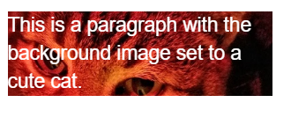
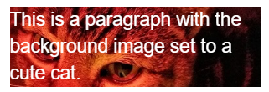
BACKGROUND IMAGES
Can set background of an element as an image (instead of a color) with the property background-image
The value is url("path"), where path is the relative or absolute path to where the image lives, like this:
p {
background-image: url("images/kitten.jpg");
color: white;
}

Slide 53
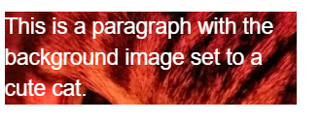
BACKGROUND IMAGES
p {
background-image: url("images/kitten.jpg");
color: white;
}
The amount of image that displays in the background is calculated based on image size and container size.
Make sure to resize images so that the part you want visible is within the “view window”
Or…

Slide 54

BACKGROUND POSITION EXAMPLES
background-position: allows you to move a background image around within its container
By default, an image is positioned at the top left side of the container
section {
background-image: url("octopus.jpg");
background-position: top left;
}
Image width: 600px by 800px

Slide 55
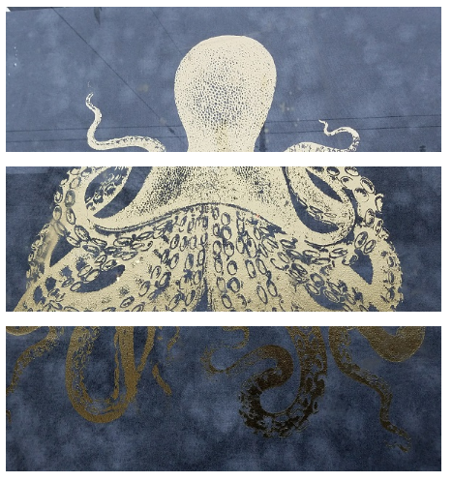
BACKGROUND POSITION EXAMPLES
Container width: 600px by 200px
background-position: top left;
background-position: center center;
background-position: bottom right;

Slide 56
BACKGROUND repeat
background-repeat: defines if (and how) the background image will repeat
By default, background images are repeated until they fill the entire container
p {
background-image: url("codepen.gif");
background-repeat: repeat;
}

Slide 57

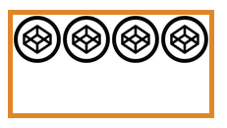


BACKGROUND repeat
repeat: tile the image in both directions
repeat-x: tile the image horizontally
repeat-y: tile the image vertically
no-repeat: don't repeat, just show the
image once

Slide 58
BACKGROUND attachment
background-attachment: images usually scroll with the main view, but setting to fixed means the image stays in place when the user scrolls the page
Difficult to describe, so check out this demo or this demo
section {
background-image: url("pattern.png");
background-attachment: fixed;
}

Slide 59
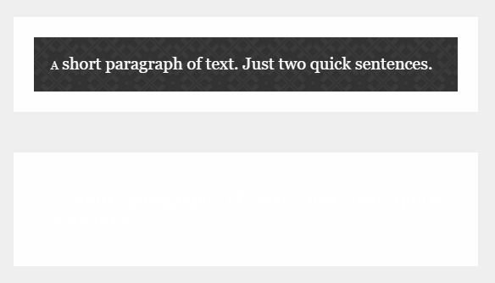
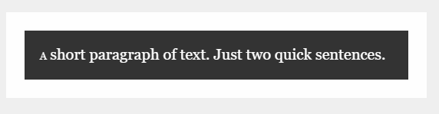
Fallback BACKGROUND color
If your background image is dark and your text is light
You may want to specify a background-color in addition to a background-image so that content is visible while the image is loading
So instead of a “blank” area…
…the user can see content while the image downloads

Slide 60


Background gradients
You can set background-image to linear-gradient, which is a gradient that the browser draws for you:
section { background: linear-gradient(black, white); }
As many colors as you want can be blended, separated by commas:
section {
background: linear-gradient(#ea992e, red, #9e5308);
}

Slide 61


Background gradients
By default linear-gradient draws from top to bottom, but you can set the gradient to draw at an angle instead by starting with to
section { background: linear-gradient(to bottom right, black, white); }
section {
background: linear-gradient(to right, red, #f06d06, yellow, green);
}

Slide 62

Background gradients
Background gradients can use rgba colors, meaning you can create a gradient that fades to transparent:
body {
background-image: url("flowers.png");
}
header {
background-image: linear-gradient(to right, rgba(255,255,255,0), rgba(255,255,255,1));
}

Slide 63
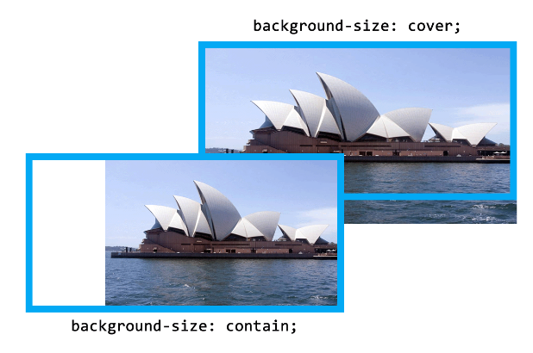
BACKGROUND size
background-size: specifies how much of the container that the image covers
cover: always cover the entire container (even if that means cropping an edge, or making the image bigger)
contain: always show the whole image (even if that means there is space on the sides or bottom)

Slide 64
Height and width
To ensure that a background image fully displays, you can set the height (and/or width) attribute on the element using CSS:
header {
background-image: url("images/hero.png");
height: 600px;
}

Slide 65
Height and width
height and width can be set on (most) elements to change how much room they take up on the page.
We’ll discuss later why elements like <a> and <em> don’t change when you set their height or width
The value of this property must be a positive number.
Units are either px or em
Or you can specify a percentage
header { height: 6em; }

Slide 66
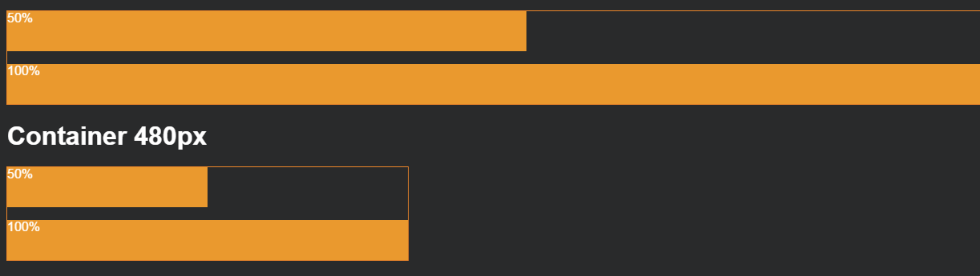
Height and width %
Percentage is based on the element’s parent’s width or height
section { width: 50%; }
If that section were inside a 480 px wide container, it would end up being 240 px wide.

Slide 67
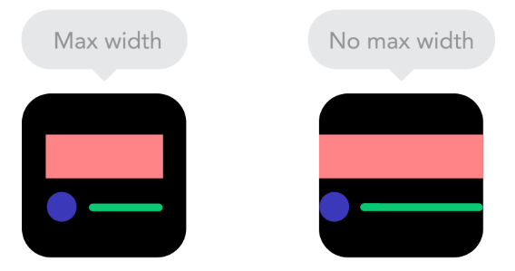
Max-Height and max-width
To ensure an element is never larger than a certain value, use max-height or max-width
Typically used to make sure content (particularly text) doesn’t spread too far out on large monitors

Slide 68
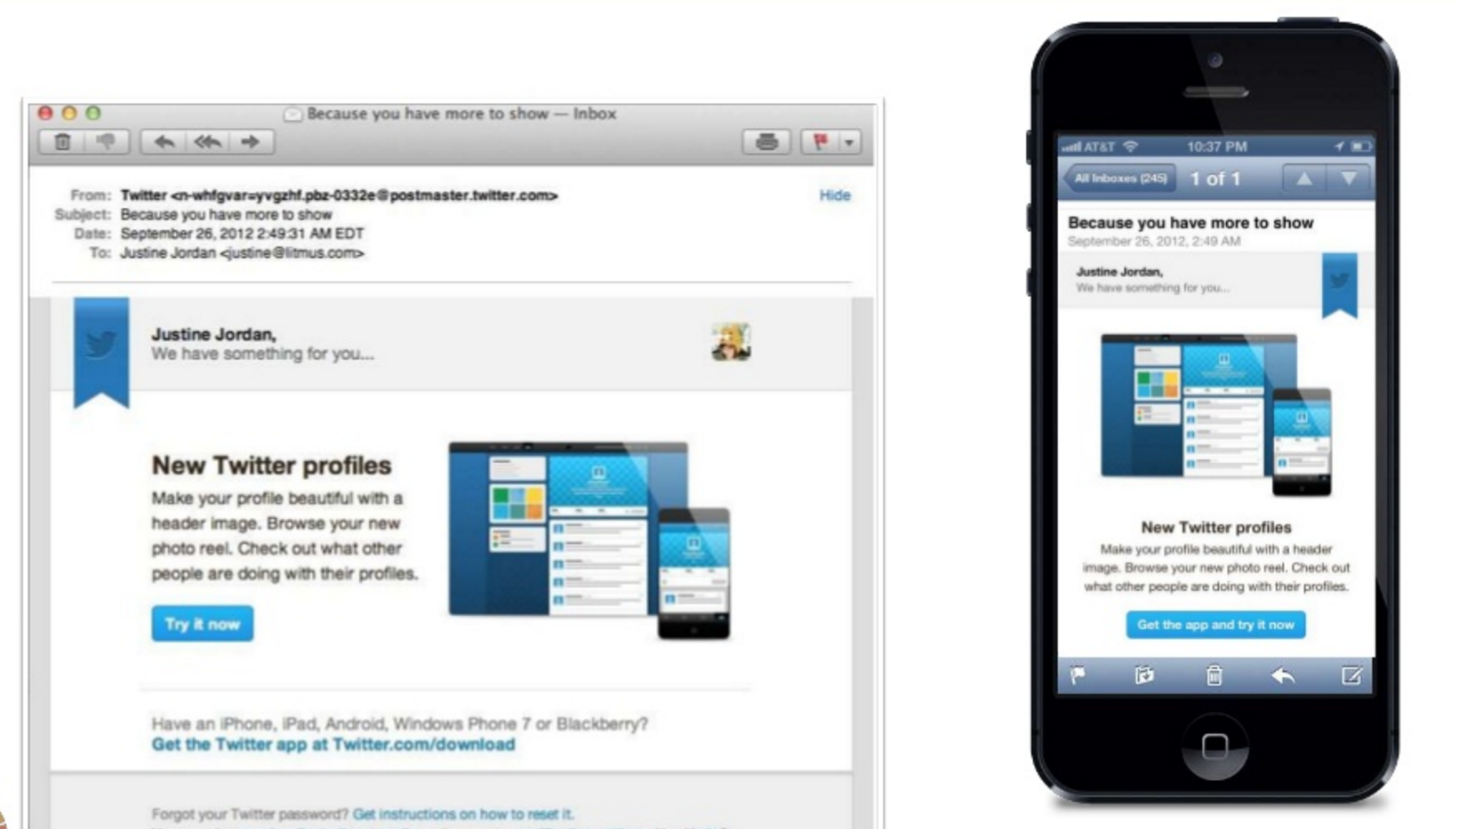
Min-Height and min-width
Specify min-height or min-width if you want to ensure an element is never smaller than a certain value.
This is especially helpful if your size is “dynamic” (based on percentage) and will vary depending on device
img {
width: 50%;
min-width: 350px;
}

Slide 69
Min-maxing
height and width fix an element to a specific size regardless of display size
If width is wider than the display – scroll bars
If width is smaller than the display – content may wrap even if there is room
min-height, min-width, min-height, and min-width allow elements to change when the display size changes, but still allow some control over presentation.

Slide 70
Min-maxing
You can choose to set only width and/or height, only min-width/min-height, and only max-width/max-height – or any or all of them, depending on your design.
For example, this section will expand up to 500 px wide, and then get no bigger. If you shrink your browser, it will shrink until its 100 px wide, and then get no smaller.
section {
min-width: 100px;
max-width: 500px;
}

Slide 71

Not all heroes wear capes
A common use of background-image is to create a “hero” image with text overlaying it

Slide 72


Slide 73
PRACTICE TIME!

Slide 74
Make a hero
Add a “hero image” to your site.
Play around with a bunch of the background properties we learned to make your hero look pretty
Try setting a width and height. What happens when you resize your browser window? Change to min-width – what changes?

Slide 75
HOMEWORK
Before next week, edit about.html
Link to an external CSS file (consider using the styles.css file you created in class today)
Make a style “override” that is specific to this page
Either inline as an or in the page head
Email your HTML and CSS files to beckjohnson@gmail.com

Slide 76

“HOMEWORK”
Practice!
Optional: read chapters 10-12 and chapter 16 of HTML and CSS: Design and Build Websites
Check out the CSS Zen Garden for inspiration on how simply changing CSS can change the entire look and feel of a page

